Slide 1
Introduction To OOPS, Classes, Objects

Slide 2
AGENDA
1
Constructors
2
Operators
3
Oops concepts
2
2
Classes and Objects
a
b
Inheritance
c
Polymorphism
dd7
Abstraction
e
Encapsulation

Slide 3

Constructors

Slide 4
Constructor
Constructor is a special method that gets invoked "automatically" at the time of object creation.
A constructor in Java is a special method that is used to initialize objects. The constructor is called when an object of a class is created. It can be used to set initial values for object attributes.
Rules For Constructor:
1. Constructor name must be same as class name.
2. Constructor doesn't have return type.
3. Constructor can automatically invoked.
4. Constructor should not have static.
5. Constructor can't inherit

Slide 5
public class Test{
Constructor Test(){
System.out.println(“This is constructor”);
}
}
Purpose of Constructor
The primary use of constructor in java is to initialize the instance and/or class variables.
once you create object of the class all the variables get initialize, and you don't need to write extra code for initialization of variables.

Slide 6
Constructor Example
public class Test {
int num;
String name;
Test() {
System.out.println("Constructor called");
}
public static void main(String []args){
Test testObj=new Test();
}
}
Constructor
Output:
Constructor called

Slide 7
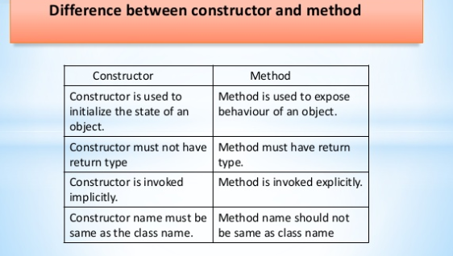
Difference between Constructors and Method

Slide 8
Types of Constructors
Types of Constructors
There are two types of constructors in Java:
Default constructor (no-arg constructor)
Parameterized constructor
Types of Constructors
Default Constructor
Parameter Constructor

Slide 9
Types of Constructors
Default Constructors
A constructor that has no parameter is known as default constructor.
If we don’t define a constructor in a class, then compiler creates default constructor(with no arguments) for the class.
And if we write a constructor with arguments or no-arguments then compiler does not create default constructor.
Advantage of Default Constructors
Default constructor provides the default values to the object like 0, null etc. depending on the type.

Slide 10
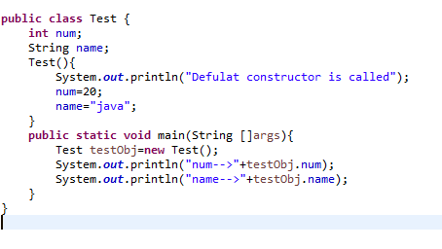
Default Constructors
Default Constructor
Output:
Default Constructor called
20
java

Slide 11
Parameterized Constructors
Parameterized Constructors
A constructor that has parameters is known as parameterized constructor.
Syntax:
Sample(param1,praram2)
{
System.out.println(“Parameter Constructor”);
}
Method arguments
Parameter Constructor
Advantage of Parameterized Constructors
The main advantage of parameter constructor is to pass different instance values.

Slide 12
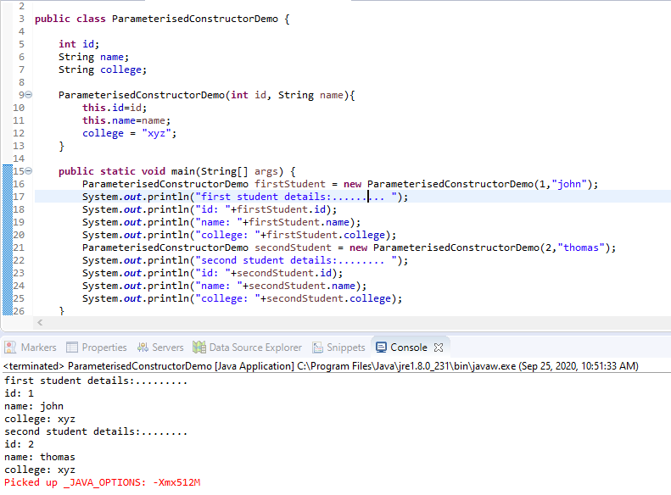
Parameterized Constructors
“this” keyword refers to the
Current object in method or
constructor

Slide 13

operators

Slide 14
Operators
ASSIGNMENT OPERATORS
OPERATOR | MEANING
= | Assignment
+= | Assignment by addition
-= | Assignment by subtraction
*= | Assignment by multiplication
/= | Assignment by division
%= | Assignment by modulo division

Slide 15
Operators
ARITHMETIC OPERATORS
OPERATOR | MEANING
+ | Addition
- | Subtraction
* | Multiplication
/ | Division
% | Modulus
Value of the expression is the wider type of its operands.
double d = 1 / 2;
byte b = 1+2; // compilation error
Strict evaluation order:
System.out.println("" + i++ + ++i); // cf. C++
Notes:
excercise: ArithmeticDemo.java
what is written?

Slide 16
Operators
RELATIONAL OPERATORS
LOGICAL OPERATORS
OPERATOR | MEANING
== | Equal to
!= | Not equal to
< | Less than
> | Greater than
<= | Less than or equal
>= | Greater than or equal
boolean ab = doA() | doB();
boolean cd = doC() || doD();
boolean ef = doE() & doF();
boolean gh = doG() && doH();
boolean ij = doI() ^ doJ();
boolean k = !doK();

Slide 17
Operators
For example, let us take , A as 60 and B as 13.
Binary value of 60 is 111100
Binary value of 13 is 001101
(~A ) will give -61 which is 1100
A << 2 will give 240 which is 1111 0000
A >> 2 will give 15 which is 1111
(A | B) will give 61 which is 0011 1101
(A & B) will give 12 which is 0000 1100
(A ^ B) will give 49 which is 0011 0001
BITWISE AND BIT SHIFT OPERATORS
OPERATOR | MEANING
~ | Unary bitwise complement
<< | Signed left shift
>> | Signed right shift
| | Bitwise or
& | Bitwise AND
^ | Bitwise exclusive OR
Notes:
Show examples: BitDemo.java

Slide 18
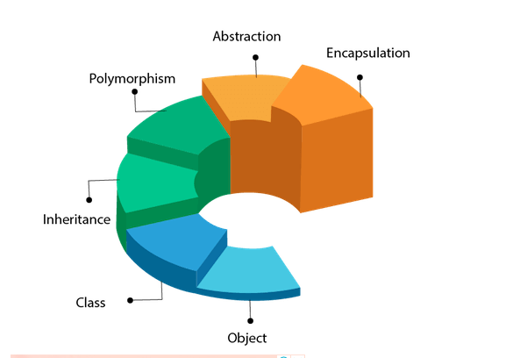
OOPS

Slide 19
Basic OOP principles
Encapsulation – hiding the internal implementation of class behavior from external environment . Only method calls are available for the external environment
Inheritance – To be able to create a new class based on existing one .
Polymorphism – The Ability to use object with same interface without information about type and internal structure of object .
Abstraction - Data abstraction is the process of hiding certain details and showing only essential information to the user.

Slide 20
Objects and Class
Any entity that has state and behavior is known as an object.
An Object can be defined as an instance of a class. An object contains an address and takes up some space in memory. Objects can communicate without knowing the details of each other's data or code.
Collection of objects is called class. It is a logical entity.
A class can also be defined as a blueprint from which you can create an individual object. Class doesn't consume any space.

Slide 21
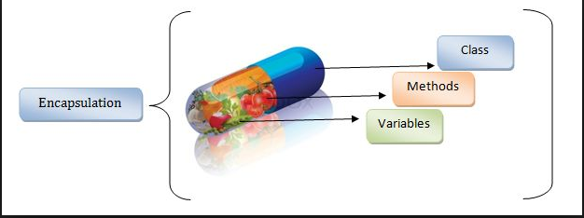
Encapsulation
Encapsulation in Java is a mechanism of wrapping the data (variables) and code acting on the
data (methods) together as a single unit.
In encapsulation, the variables of a class will be hidden from other classes, and can be accessed
only through the methods of their current class. Therefore, it is also known as data hiding.

Slide 22
Encapsulation
To achieve encapsulation in Java −
- Declare the variables of a class as private.
- Provide public setter and getter methods to modify and view the variables values.
Benefits of Encapsulation:
The fields of a class can be made read-only or write-only.
A class can have total control over what is stored in its fields.

Slide 23
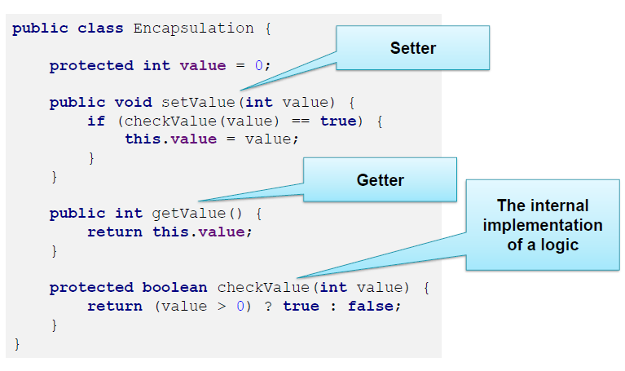
Encapsulation

Slide 24
Inheritance
One object can inherit properties of other object and add to their features (and behavior)
The class which inherits the properties of other is known as subclass (derived class, child class) and the class whose properties are inherited is known as superclass (base class, parent class).
Inheritances expresses “is-a” and/or “has-a” relationship between two objects. Using Inheritance, In derived classes we can reuse the code of existing super classes.
extends is the keyword used to inherit the properties of a class.
Syntax:
class Super { .....
..... }
class Sub extends Super { ..... ..... }

Slide 25
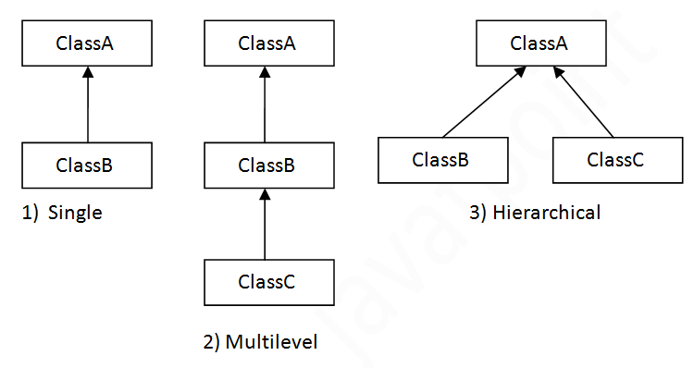
Inheritance

Slide 26
Super keyword
The super keyword in java is a reference variable that is used to refer parent class objects.
The keyword “super” came into the picture with the concept of Inheritance.
Call to super() must be first statement in DerivedClass constructor.
If a constructor does not explicitly invoke a superclass constructor, the Java compiler automatically inserts a call to the no-argument constructor of the superclass.

Slide 27
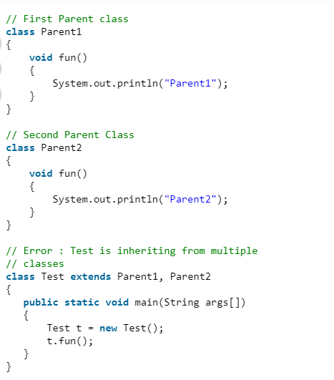
Multiple Inheritance
Multiple Inheritance is a feature of object oriented concept, where a class can inherit properties of more than one parent class.
The problem occurs when there exist methods with same signature in both the super classes and subclass.
On calling the method, the compiler cannot determine which class method to be called and even on calling which class method gets the priority.

Slide 28
Method overloading
If a class has multiple methods having same name but different in parameters, it is known as Method Overloading.
If we have to perform only one operation, having same name of the methods increases the readability of the program.
Bad practice:
class A{
public int add1(int a, int b){ return a+b; }
public int add2(int a, int b, int c){ return a+b+c; }
}

Slide 29
Method overloading
There are two ways to overload the method in java
By changing number of arguments
By changing the data type
Can we overload java main() method?
Yes, by method overloading. You can have any number of main methods in a class by method
overloading. But JVM calls main() method which receives string array as arguments only.
Let's see the simple example:
class TestOverloading4{
public static void main(String[] args){System.out.println("main with String[]");}
public static void main(String args){System.out.println("main with String");}
public static void main(){System.out.println("main without args");}
}

Slide 30
Abstraction
Data abstraction is the process of hiding certain details and showing only essential information to the user.
Abstraction can be achieved with either abstract classes or interfaces.
The ‘abstract’ keyword can be used with classes and methods.
Abstract class - is a restricted class that cannot be used to create objects (to access it, it must be inherited from another class).
Abstract method - can only be used in an abstract class, and it does not have a body. The body is provided by the subclass (inherited from).

Slide 31
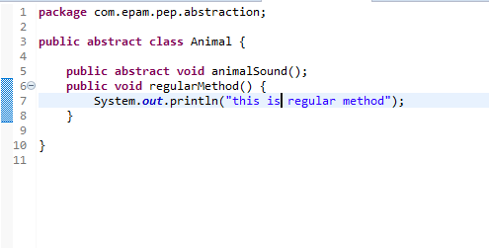
Abstract Class
An abstract class can have both abstract and regular methods.

Slide 32
Interfaces
An interface in Java is a blueprint of a class. It has static constants and abstract methods.
The interface in Java is a mechanism to achieve abstraction.
In other words, you can say that interfaces can have abstract methods and variables. It cannot have a method body.
An interface is declared by using the ‘interface’ keyword.
All the fields declared in interface are public, static and final by default.
A class that implements the interface must implement all the methods declared in an interface.

Slide 33
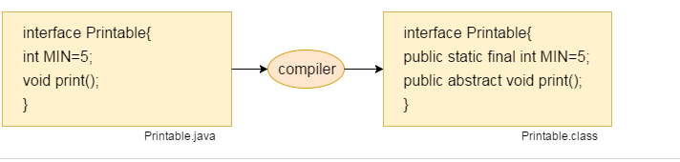
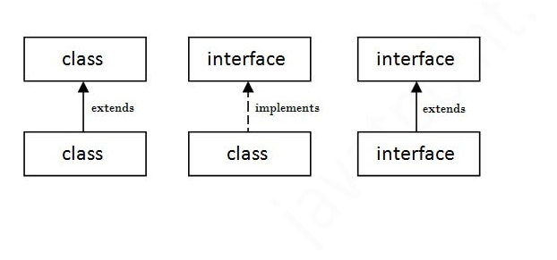
Interfaces

Slide 34
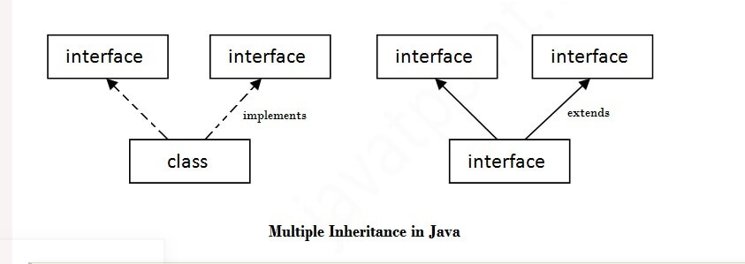
Multiple inheritance with interfaces
If a class implements multiple interfaces, or an interface extends multiple interfaces, it is known as multiple inheritance.

Slide 35
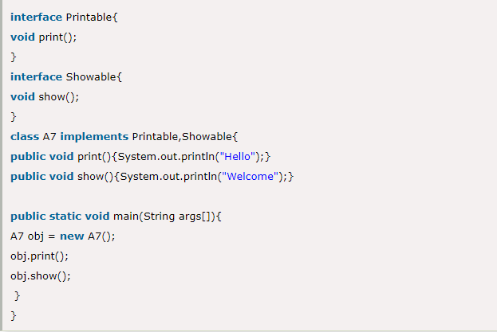
Multiple inheritance with interfaces
If a class implements multiple interfaces, or an interface extends multiple interfaces, it is known as multiple inheritance.

Slide 36
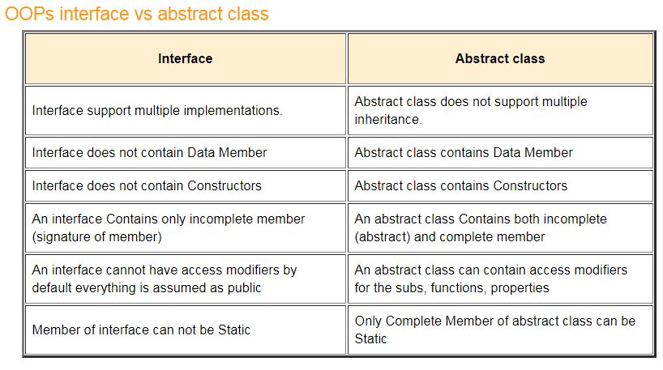
Difference between Interface and Abstract Class

Slide 37
Polymorphism
Polymorphism means "many forms", and it occurs when we have many classes that are related to each other by inheritance.
Polymorphism allows one and same name to solve two or more similar but technically different tasks
Inheritance lets us inherit attributes and methods from another class. Polymorphism uses those methods to perform different tasks. This allows us to perform a single action in different ways.
There are two types of polymorphism in Java:
compile-time polymorphism and runtime polymorphism.
We can perform polymorphism in java by method overloading and method overriding.

Slide 38
Compile time Polymorphism
If you overload a static method in Java, it is the example of compile time polymorphism.
public class Test {
public static void foo() {
System.out.println("Test.foo() called ");
}
public static void foo(int a) {
System.out.println("Test.foo(int) called ");
}
public static void main(String args[])
{
Test.foo();
Test.foo(10);
} }

Slide 39
Run time Polymorphism
Runtime polymorphism or Dynamic Method Dispatch is a process in which a call to an overridden method is resolved at runtime rather than compile-time.
In this process, an overridden method is called through the reference variable of a superclass. The determination of the method to be called is based on the object being referred to by the reference variable.
If there exists a method in super class and sub class, then the method is said to be overridden
If the reference variable of Parent class refers to the object of Child class, it is known as upcasting. For example:
class A{}
class B extends A{}
A a=new B();//upcasting

Slide 40
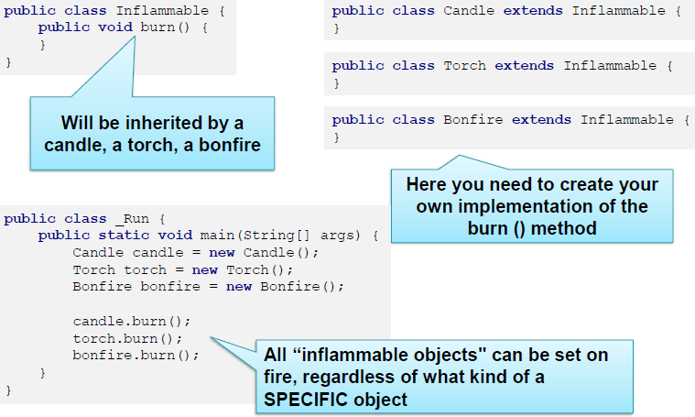
Polymorphism

Slide 41
Practice Programs
Write a program to print the names of students by creating a Student class. If no name is passed while creating an object of Student class, then the name should be "Unknown", otherwise the name should be equal to the String value passed while creating object of Student class.
Create an abstract class 'Animals' with two abstract methods 'cats' and 'dogs'. Now create a class 'Cats' with a method 'cats' which prints "Cats meow" and a class 'Dogs' with a method 'dogs' which prints "Dogs bark", both inheriting the class 'Animals'. Now create an object for each of the subclasses and call their respective methods.

Slide 42
Thank You

